Slide 1

A Class of Wine
June Blender
Technology Evangelist
SAPIEN Technologies, Inc.
juneb@sapien.com
@juneb_get_help
Creating Classes in the windows PowerShell 5.0 Preview

Slide 2

What is a class?
In Windows PowerShell, a class defines a type of object.
The class is not an object.
It's like a specification of an object.
You can create objects based on the specification.

Slide 3

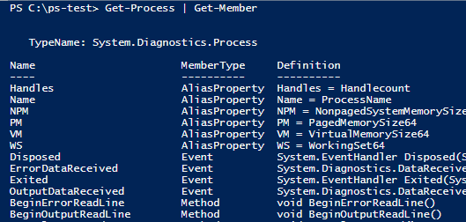

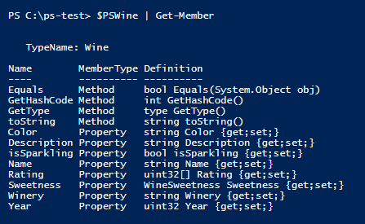
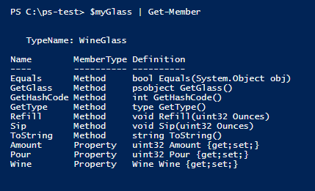

To discover classes, use Get-Member
Wine
WineGlass

Slide 4

What is an instance?
It's an object that's based on a class.
Like a house that's built from a model (but more reliable!)
It has the properties and methods that the class defines, like Roof and Door.
But it's property values might differ from other instances, like: Roof = Composite Door = 1

Slide 5
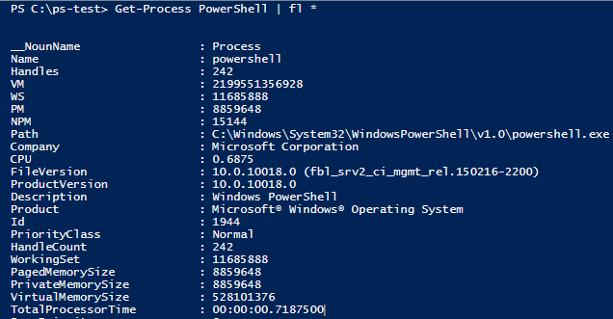
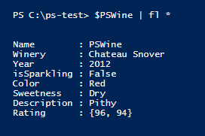
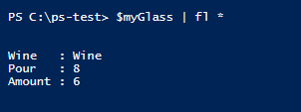
To discover instances, use Format-List -Property * (fl *)
Wine
WineGlass

Slide 6
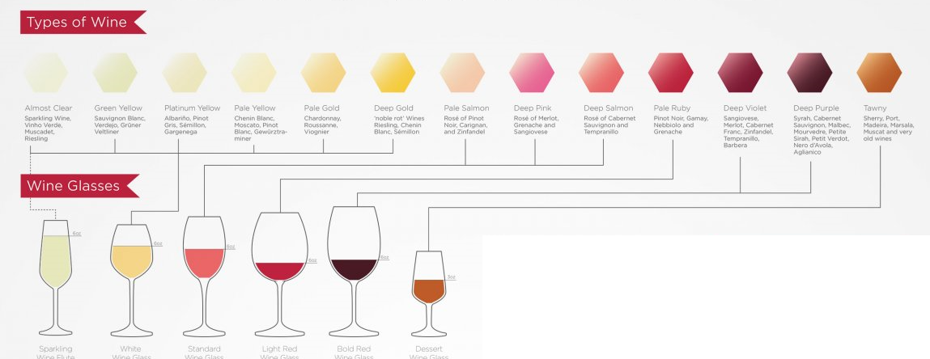
A Wine class and a WineGlass class

Slide 7
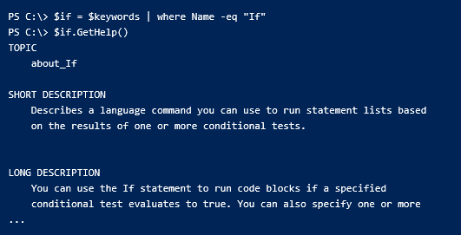
Why?
You create custom objects … from hash tables, CSV files, Select-Object
What if you could create classes -- reusable object models -- with methods?

Slide 8

Classes: The Final Frontier
Write a script
Create a module
Write a function
DevOps Continuum
Run scripts
Create a class
Run cmdlets
Script with your own classes

Slide 9
Demo: Wine Class
Define the Wine class
Create instances of the Wine class
Use their properties and methods
You can't create types at the command-line, because "you can't use a type literal ([MyClass]) outside the script/module file in which the class is defined."
New-Object doesn't work, because "you can't refer to the type name as a string."

Slide 10
Create a class : Class keyword
Syntax:
class <className> { }
Example:
class Wine { }

Slide 11
Add properties
Syntax:
class <className> {
[<Attribute>] [<Type>] <PropertyName> [ = <defaultValue>] }
Example:
class Wine
{
[String] $Name
}

Slide 12
Add properties
Syntax:
class <className> {
[<Attribute>] [[<Type>]] <PropertyName> }
class Wine
{
$Name
[ValidateSet("Red", "White", "Rose")]$Color
[int32]$Year = (Get-Date).Year
}

Slide 13
Wine class properties
class Wine
{
[String] $Name
[String] $Winery
[Int32] $Year
[Boolean] $isSparkling = $False
[ValidateSet("Red", "White", "Rose")][String] $Color
[WineSweetness] $Sweetness
[String] $Description
[Int] $Price
}

Slide 14
Add methods : syntax
[returnType] <methodName> ([<parameters>]) {
<process parameter values>
[return] <returnType expression> }

Slide 15
Add methods : syntax
[returnType] <methodName> ([<parameters>]) {
<process parameter values>
[return] <returnType expression> }
-- Parentheses around parameters are required ()
-- All parameters are mandatory and positional
-- Multiple methods with same name and different parameter types ("overload")
-- Default return type is void (nothing)
-- All paths of method must return the return type
-- Return keyword is required to return anything (no standard output)
-- Parameter "(" must be on first line

Slide 16
Return Types: Contract
Optional. The default is "[void]" : Cannot return anything.
Every logical path must return the same type.
Return keyword is required.
[String] GetHelp()
{
[String]$firstRef = $this.Reference.Split(",").Trim() | Select-Object -First 1
try
{
return Get-Help $firstRef
}
catch
{
return ""
}
}

Slide 17
$this
Refers to the current instance of the class ($_ for classes)
Distinguishes properties from parameters and variables.
class Tree
{
#Properties
[String] $Species
[Int32] $Height
Tree ($Species, $Height) {
$this.Species = $Species
$this.Height = $Height
}
}

Slide 18
Wine class methods
class Wine
{
...
# toString() # Override: Returns a human-readable string.
[String] toString()
{
$color = $this.Color
if ($this.isSparkling) {$color = "Sparkling $color"}
return "$color Wine: $($this.Name) `
$($this.Year) by $($this.Winery). `
Priced at: $("{0:C}" -f $this.Price). `
Described as: $($this.Description). "
}
}

Slide 19
Add methods : Example
#Properties
[int] $Amount
#Methods
[String] Sip ([Int]$Ounces, [String]$Response) {
if ($this.Amount -ge $Ounces)
{
$this.Amount -= $Ounces return "Oh! $Response"
}
}

Slide 20
Calling class methods
No parameter names; All parameters are mandatory and positional; Parentheses are required
[String] Sip ([Int]$Ounces, [String]$Response) {
if ($this.Amount ge- $Ounces)
{
$this.Amount -= $Ounces
return "Oh! $Response"
} }
$myWine.Sip(2, "What a delightful finish!")
$myWine.Sip("what a delightful finish", 2)
$myWine.Sip(2)
$myWine.Sip(-Amount 2 -Response "what a delightful finish")

Slide 21
Create a wine (instance of the Wine class)
(Feb. v5.0.10018.0)
To create an instance of a class, use the New static method.
The parameters of the New method match a constructor.
New-Object doesn't work, because "you can't refer to the type name as a string."
You can't create types at the command-line, because "you can't use a type literal ([MyClass]) outside the script/module file in which the class is defined."

Slide 22
Constructors : about constructors
Special methods for creating an instance of the object.
Constructor name is always the class name.
Multiple constructors for a class.
Each constructor must take a different number or type of parameter values.
Windows PowerShell adds a null constructor (no parameters) to every class.

Slide 23
Constructors
# Constructors
Wine () {} # Null constructor; Automatic in Windows PowerShell
Wine ([string]$Name) {$this.Name = $Name}
Wine ([string]$Name, [int][ValidateRange(10, 10000)]$Price)
{
$this.Name = $Name
$this.Price = $Price
}
$myWine = [Wine]::new() #Using null constructor
$myWine = [Wine]::new("Great Duck")
$myWine = [Wine]::new("PSWine", 40) #No parameter names!

Slide 24
Calling a constructor: create new instance
[<className>]::New(<constructor>)
Constructor:
Wine () {}
Call:
$myWine = [Wine]::New()
Constructor:
Wine ([string]$Name, [int]$Price)
{
$this.Name = $Name
$this.Price = [ValidateRange(10, 10000)$Price
}
Call:
$myWine = [Wine]::new("PSWine", 40) #No parameter names!
$myWine = [Wine]@{Name="PSWine"; Price=40} #Requires null/"parameter-less" constructor

Slide 25
Create a wine (hash table)
(Feb. v5.0.10018.0)
$myWine = [Wine]::New() # Must be explicit
$myWine = [Wine]@{Name="Great Duck";
Winery="Escalante Winery";
Year="2003";
isSparkling = $True;
Color = "White";
Sweetness = 4;
Description= "Rich and magnificent";
Price = 22}

Slide 26
Interacting Classes
Create a WineGlass class
class WineGlass
{
[Wine]$Wine
[Int] $Size
[Int] Amount
Sip ($Amt) { ... }
Sip() {...}
Pour ($Amt) { ... }
Refill()
...
}

Slide 27
Enumerated types ("enums")
enum WineSweetness
{
VeryDry
Dry
Moderate
Sweet
VerySweet
}
enum WineSweetness {VeryDry; Dry; Moderate; Sweet; VerySweet}
class Wine
{
#Properties
...
[WineSweetness] $Sweetness ...
}

Slide 28
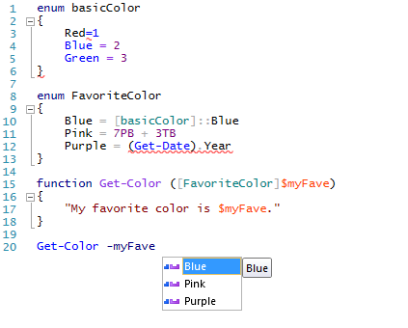
Enum value rules
Default values are zero-based integers.
You can change to a different int, but you can't change the base type.
Values can be expressions that return an int.
Can't be the result of an invoked command. ("Must be a parse-time constant.")
You can't define it or refer to it at the command-line. ("You can't use a type literal outside the script/module file in which the class is defined.")

Slide 29
Using enums
enum WineSweetness {VeryDry; Dry; Moderate; Sweet; VerySweet}
#Properties
[WineSweetness] $Sweetness
$myWine.Sweetness = 4
$hisWine.Sweetness = VerySweet

Slide 30
Enums: set alternate int values
enum WineSweetness
{
VeryDry = 10
Dry = 20
Moderate = 50
Sweet = 90
VerySweet = 100
}
class Wine
{
#Properties
...
[WineSweetness] $Sweetness ...
}

Slide 31
Get/Set Property Values (in other languages)
class Wine {
[String] $Name
...
}
$myWine = [Wine]::new()
$myWine.Name = "Great Duck"
Error: Name is a read-only property. #Not PowerShell
$myTree.Name
Error: Name is a private value. #Not PowerShell

Slide 32
Automatic Getters/Setters
class Wine {
[String] $Name
}
$myTree = [Wine]::new()
$myTree.set_Name = "Sycamore" # Set the property value
$myTree.get_Name # Get the property value Sycamore

Slide 33
Automatic Getters/Setters
When you create a property in a scripted class, Windows PowerShell adds get and set methods for you.
All properties are public (you can get the value) and read-write (you can change the value).
All variables in a class are properties of the class.
class Wine { $Name }
$myWine = [Wine]::new()
$myWine | Get-Member -Force ...
get_Name Method string get_Name()
set_Name Method void set_Name(string )
Name Property string Name{get;set;}

Slide 34
Hidden: sort of…
Hidden keyword
Hidden hides them from Get-Member and other cmdlets (Format-List *), but you can see them in Get-Member -Force.
class WineGlass : Glass
{
hidden [int] Consumed
hidden [int] TotalPoured
}

Slide 35


Inheritance
Hierarchy of classes
Child classes inherit properties and methods (and events and other members) from parent classes
If they don't like them, they can override them.
Terminology:
Parent class: Superclass, base class
Child class: Subclass

Slide 36
Inherit from System.Object
All .NET classes are derived from System.Object ("superclass")
Superclass System.Object System.Object
| | |
Subclass Wine, Tree Glass
|
WineGlass

Slide 37
Inherit from other classes
Base a scripted class on a .NET class (inheritable, not sealed)
Base a scripted class on another scripted class
System.Object System.Object System.Object
| | |
Wine, Tree Glass KeyedCollection (.NET class)
| |
WineGlass FileCollection

Slide 38
Create a subclass : syntax
class <subClassName> : <SuperClass>
class WineGlass : Glass {}

Slide 39

Scripted classes inherit from System.Object
PS C:\ps-test> $myObj = New-Object -TypeName System.Object
PS C:\ps-test> $myObj | Get-Member
TypeName: System.Object
Name MemberType Definition
---- ---------- ----------
Equals Method bool Equals(System.Object obj)
GetHashCode Method int GetHashCode()
GetType Method type GetType()
ToString Method string ToString()
class Wine { }
$myWine = [Wine]::new()
PS C:\ps-test> $myWine | Get-Member
TypeName: Wine
Name MemberType Definition
---- ---------- ----------
Equals Method bool Equals(System.Object obj)
GetHashCode Method int GetHashCode()
GetType Method type GetType()
ToString Method string ToString()
System.Object is a "superclass" (parent)
Scripted class is a "subclass" (child)
Subclasses
Superclass

Slide 40
Overload: Same name, different signature
In same class or parent class
Drink ([int]Amount) { ... }
Drink () { ... }

Slide 41
Override: Same name, same signature
In superclass class and subclass : Local takes precedence
class Glass {
Drink ([int]Amount) { ... }
}
class WineGlass : Glass {
Drink ([int]Amount) { ... }
}

Slide 42

Interfaces
An interface is a like a contract.
It guarantees that classes have the members (properties/methods/events) that it specifies.
But, the interface does not specify how the members work.
Classes that "sign the contract" implement the interface.
They have the members that the interface specifies ("signature").
Each class can implement multiple interfaces.
Classes can inherit multiple interfaces and override them.

Slide 43
Interfaces in .NET
IEnumerable: enumerating, foreach
IComparable: sorting
IClonable: duplicate instances of the class
IFormattable: change toString() behavior
IDisposable: garbage collection, releasing unused resources
To find the interfaces a class implements:
[<className>].ImplementedInterfaces # PowerShell 4.0
[<className>].GetInterfaces() # PowerShell 5.0

Slide 44
Interfaces : syntax
Scripted classes can implement interfaces
You cannot (yet?) create/define interface
class <className> : <interfaceName>
class <className> : <superclass>, <interfaceName> [,<interfaceName>, ...]

Slide 45
Get-Help
Script help, About topics
Best practices:
-- Examples: -- Show how to create an instance (constructors). -- Show how to use the properties and methods.
-- Explain the purpose of the class and its instances.
-- Describe the properties and their values.
-- Explain the methods, their parameters/values, and return values.
-- Note inheritance, interfaces, overrides.

Slide 46
Classes in 5.0.10018.0
You can create scripted classes in Windows PowerShell 5.0 preview.
class <className> [: <Superclass>, <Interface]
Classes have constructors to make instances of the class
Classes have properties and methods.
Windows PowerShell adds getter/setter methods for properties.
Classes can inherit from other classes (and System.Object)
You can override inherited methods.
Classes can implement .NET interfaces.
You can include classes in scripts and modules.
You can write help for classes.

Slide 47
Classes: The Final Frontier
Write a script
Create a module
Write a function
DevOps Continuum
Run scripts
Create a class
Run cmdlets
Script with your own classes

Slide 48
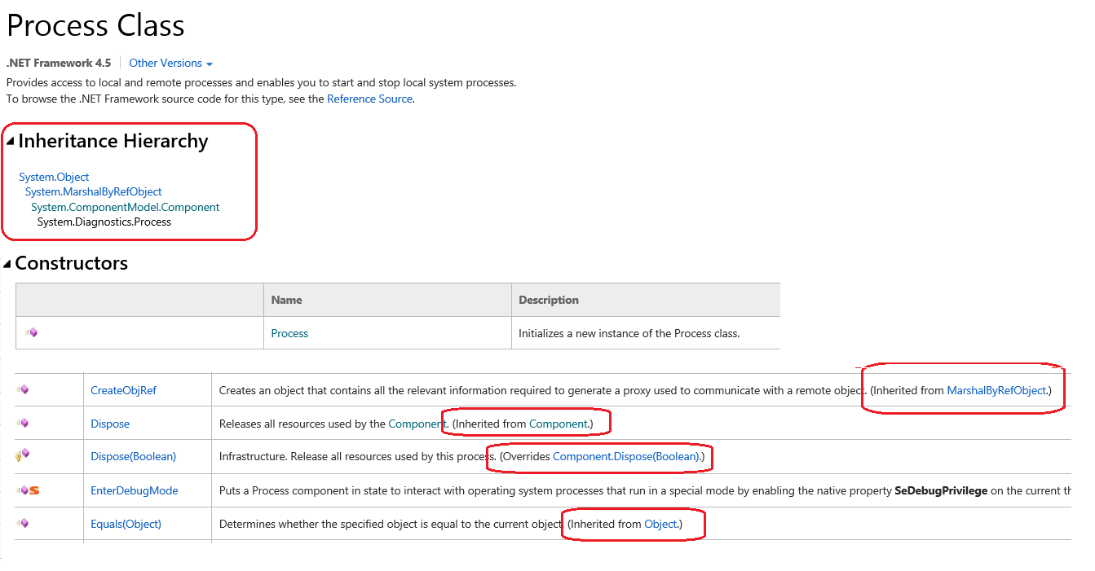
Understanding MSDN

Slide 49
Resources
about_Classes
Release Notes
Implementing a .NET Class in PowerShell v5 by Trevor Sullivan
Playing with Classes in PowerShell v5 Preview by Lee Holmes
Writing Classes With PowerShell V5-Part 1 & 2 by Thomas Lee
Beyond custom objects: Create a .NET class by June Blender
Enumerated Types in Windows PowerShell 5.0 by June Blender

Slide 50
Thanks!
Trevor Sullivan
Sergei Vorobev
Joel Bennett
Doug Finke

Slide 51
A Class of Wine
June Blender
Technology Evangelist
SAPIEN Technologies, Inc.
juneb@sapien.com
@juneb_get_help
Creating Classes in the windows PowerShell 5.0 Preview

